Slide 1
Operating SYSTEMS Internals

Slide 2
Chapter 1: Introduction

Slide 3
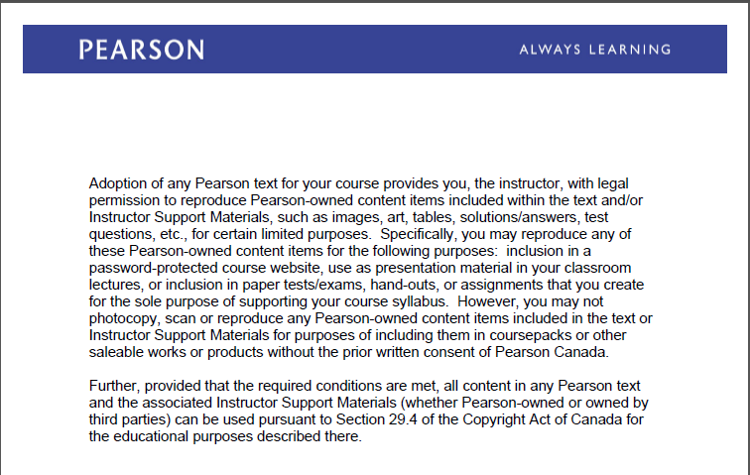
Text Book Slides -Copy Right

Slide 4
Chapter 1: Introduction
Define an operating system
Computer-System Organization
Computer-System Architecture
Operating systems components – Process, memory and storage management
Special-Purpose Systems
Overview of Computing Environments
Open-Source Operating Systems

Slide 5
What is an Operating System?
Operating System: A program ( code) written in high-level programming language such as C and C++ that conveniently provides computer system resources to users/applications of a computer system.
What are the “resources”?
Who/what are the “users”?
What is meant by “conveniently”?

Slide 6
What is an Operating System?
Operating System manages system’s hardware and software and it can be defined from different points of view.
From the system point of view:
OS is a resource allocator
Manages all system resources such as CPU time, Memory space, file-storage space, I/O devices
OS is a control program
Controls execution of programs to prevent errors and improper use of the system

Slide 7
OS Definition
From the user point of view the operating systems should be fast and ease to use
Operating system is the kernel (main functions ) required to run the system– a program running at all times on the computer. Other instructions or lines of code are considered system programs (ships with the operating system) associated with the OS but not part of the kernel.

Slide 8
Operating Systems
Operating Systems Timeline
https://en.wikipedia.org/wiki/Timeline_of_operating_systems
Windows Timeline
https://en.wikipedia.org/wiki/Timeline_of_Microsoft_Windows
Linux History
https://www.youtube.com/watch?gl=SG&hl=en-GB&v=AvfTZmecifc

Slide 9
Linux and POSIX
POSIX (Portable Operating Systems Interface , based on UNIX)
Intended to standardize Unix operating systems.
Originated by the ISO, but in 1986 IEEE appointed a committee to publish a formal standard for Operating systems environment called POSIX.1, published in 1990
POSIX.1 : is a C programming language interface standard. Specifies syntax and semantics
POSIX.2: Specifies the syntax and semantics of a shell command language
POSIX.3 and 4: Specifies test methods for measuring conformance to POSIX standards
POSIX.17 : Standards for X.500 Directory services

Slide 10
Operating System Structure
Batch Job Processing
Jobs with similar needs running through the computer as a group. This system is good for executing large jobs that need little interaction.
Multiprogramming needed for efficiency
Single user cannot keep CPU and I/O devices busy at all times
Multiprogramming organizes jobs (code and data) so CPU always has one to execute
A subset of total jobs in system is kept in memory
One job selected and run via job scheduling
When it has to wait (for I/O for example), OS switches to another job

Slide 11
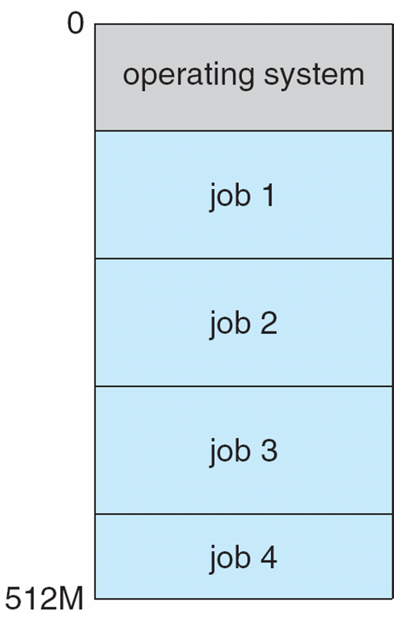
Memory Layout for Multiprogrammed System

Slide 12
Operating System Evolution
Timesharing (TS) (multitasking) CPU switches jobs so frequently that users can interact with each job while it is running, creating interactive computing
Response time should be < 1 second
Each user has at least one program executing in memory process
If several jobs ready to run at the same time  CPU scheduling
If processes don’t fit in memory, swapping moves them in and out to run
Virtual memory allows execution of processes that are not completely in memory

Slide 13
Real-Time Systems
Real-Time Systems –Hard and Soft
Real time systems are critical-time systems that provide inmediate response
Real time systems are classified as hard real time systems such as medical systems, NASA, process control system or soft real time systems are less time-critical systems that allow delay such as games, multimedia, virtual reality

Slide 14
Computer SYSTEM COMPONENTS

Slide 15
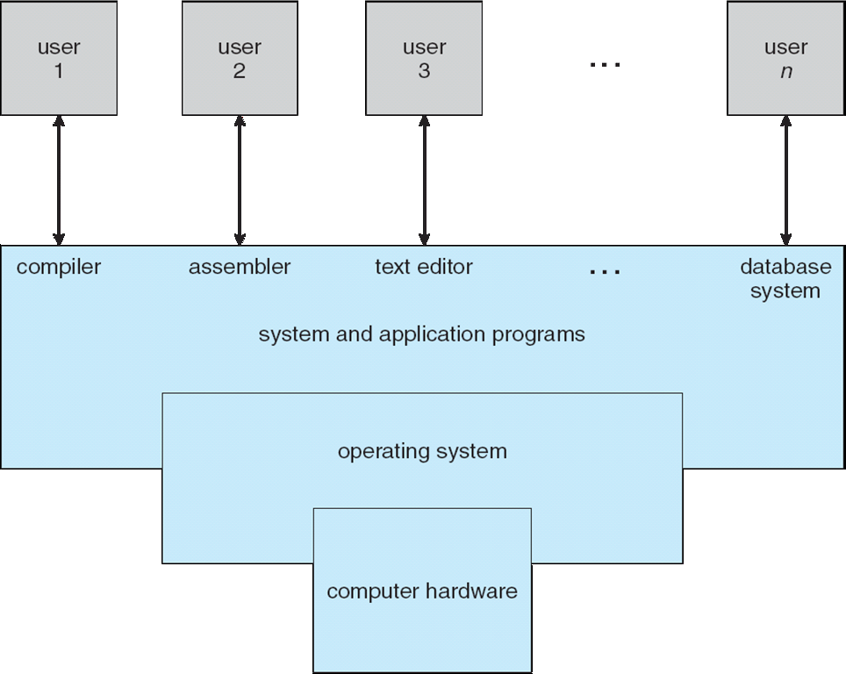
Computer System Components

Slide 16
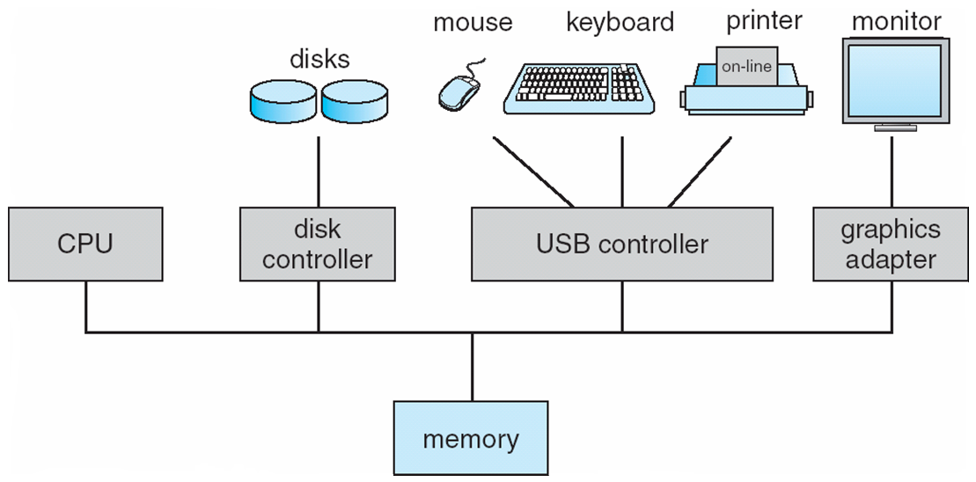
Computer System Organization
Computer-system operation
One or more CPUs, device controllers connect through common bus providing access to shared memory
Concurrent execution of CPUs and devices competing for memory cycles.

Slide 17
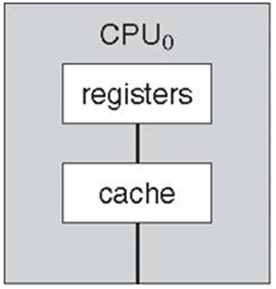
CPU Components

Slide 18
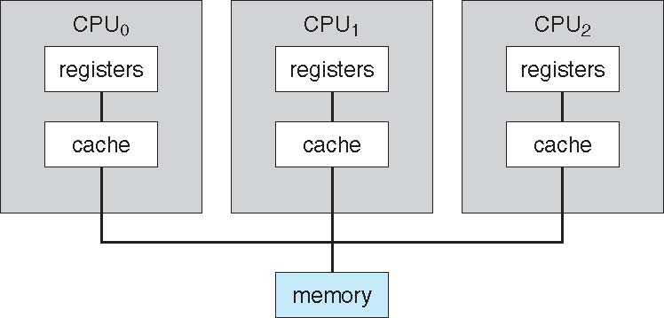
Symmetric Multiprocessing Architecture

Slide 19
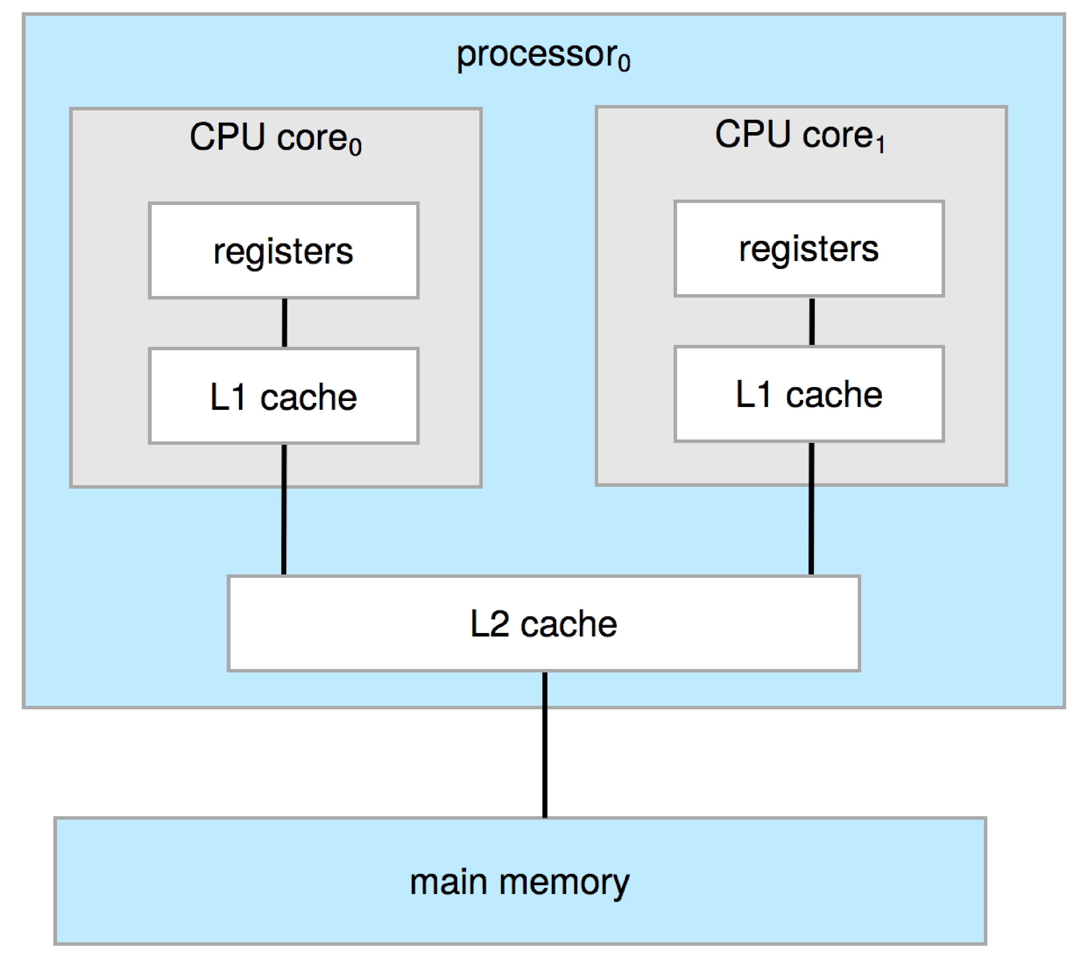
A Dual-Core Design
Multi-chip and multicore
Systems containing all chips
Chassis containing multiple separate systems

Slide 20
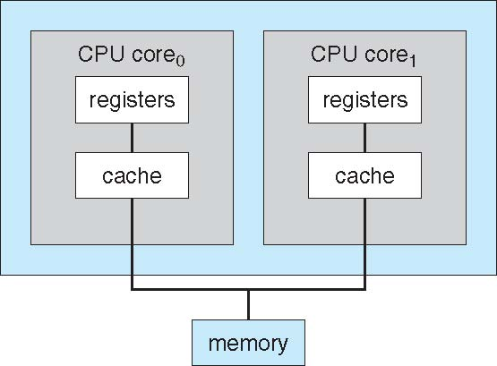
A Dual-Core Design
It supports UMA (Uniform Memory Access) and NUMA(Non-Uniform memory Access)
Multi-chip and multicore
Chassis containing multiple separate systems

Slide 21
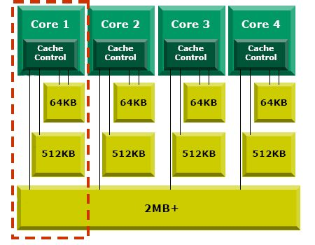
Quad Core

Slide 22
ARM Processor
The future of Microprocessors by Sophie Wilson (ARM inventor)
https://www.youtube.com/watch?v=_9mzmvhwMqw
ARM processor Fundamentals

Slide 23
Clustered Systems
Like multiprocessor systems, but multiple systems working together
Usually sharing storage via a storage-area network (SAN)
Provides a high-availability service which survives failures
Asymmetric clustering has one machine in hot-standby mode
Symmetric clustering has multiple nodes running applications, monitoring each other
Some clusters are for high-performance computing (HPC)
Applications must be written to use parallelization
Some have distributed lock manager (DLM) to avoid conflicting operations.

Slide 24
Clustered Systems
Windows Server 2012 – Two-node cluster
http://www.youtube.com/watch?v=OGIs5M_gqAU

Slide 25
OS components

Slide 26
Operating Systems Components
Process and Threads Management
Memory Management
Storage and File System Management
Device Management
Network Management

Slide 27
Process Management
A process is a program in execution. It is a unit of work within the system. Program is a passive entity, process is an active entity.
Process needs resources to accomplish its task
CPU, memory, I/O, files
Initialization data
Process termination requires reclaim of any reusable resources
Single-threaded process has one program counter specifying location of next instruction to execute
Process executes instructions sequentially, one at a time, until completion
Multi-threaded process has one program counter per thread
Typically system has many processes, some user, some operating system running concurrently on one or more CPUs
Concurrency by multiplexing the CPUs among the processes / threads

Slide 28
Memory Management
All data in memory before and after processing
All instructions in memory in order to execute
Memory management activities
Keeping track of which parts of memory are currently being used and what programs are using it
Deciding which processes and data to move into and out of memory
Allocating and deallocating memory space as needed

Slide 29
Storage and File System Management
OS provides uniform, logical view of information storage
Abstracts physical properties to logical storage unit - file
Each medium is controlled by device (i.e., disk drive, tape drive)
Varying properties include access speed, capacity, data-transfer rate, access method (sequential or random)
File-System management
Files usually organized into directories
Access control on most systems to determine who can access what
OS activities include
Creating and deleting files and directories
Primitives to manipulate files and dirs
Mapping files onto secondary storage
Backup files onto stable (non-volatile) storage media

Slide 30
Storage Definitions and Notation Review
The basic unit of computer storage is the bit. A bit can contain one of two values, 0 and 1. All other storage in a computer is based on collections of bits. Given enough bits, it is amazing how many things a computer can represent: numbers, letters, images, movies, sounds, documents, and programs, to name a few. A byte is 8 bits, and on most computers it is the smallest convenient chunk of storage. For example, most computers don’t have an instruction to move a bit but do have one to move a byte. A less common term is word, which is a given computer architecture’s native unit of data. A word is made up of one or more bytes. For example, a computer that has 64-bit registers and 64-bit memory addressing typically has 64-bit (8-byte) words. A computer executes many operations in its native word size rather than a byte at a time.
Computer storage, along with most computer throughput, is generally measured and manipulated in bytes and collections of bytes. A kilobyte, or KB, is 1,024 bytes; a megabyte, or MB, is 1,0242 bytes; a gigabyte, or GB, is 1,0243 bytes; a terabyte, or TB, is 1,0244 bytes; and a petabyte, or PB, is 1,0245 bytes. Computer manufacturers often round off these numbers and say that a megabyte is 1 million bytes and a gigabyte is 1 billion bytes. Networking measurements are an exception to this general rule; they are given in bits (because networks move data a bit at a time).

Slide 31
I/O Subsystem
I/O subsystem responsible for:
Memory management of I/O including buffering (storing data temporarily while it is being transferred), caching (storing parts of data in faster storage for performance), spooling (the overlapping of output of one job with input of other jobs)
General device-driver interface
Drivers for specific hardware devices
After I/O starts, control returns to user program only upon I/O completion
Wait instruction idles the CPU until the next interrupt
Wait loop (contention for memory access)
At most one I/O request is outstanding at a time, no simultaneous I/O processing

Slide 32
Computer-System Operation
I/O devices and the CPU can execute concurrently
Each device controller is in charge of a particular device type
Each device controller has a local buffer
CPU moves data from/to main memory to/from local buffers
Device controller informs CPU that it has finished its operation by causing an interrupt.

Slide 33
Common Functions of Interrupts
Interrupt transfers control to the interrupt service routine generally, through the interrupt vector, which contains the addresses of all the service routines
Interrupt architecture must save the address of the interrupted instruction
A trap or exception is a software-generated interrupt caused either by an error or a user request
An operating system is interrupt driven

Slide 34
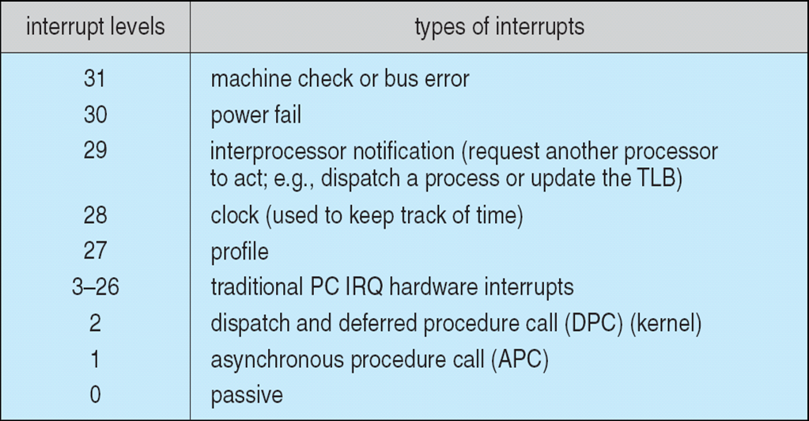
Windows 7 Interrupt Request Levels

Slide 35
Operating system Services

Slide 36
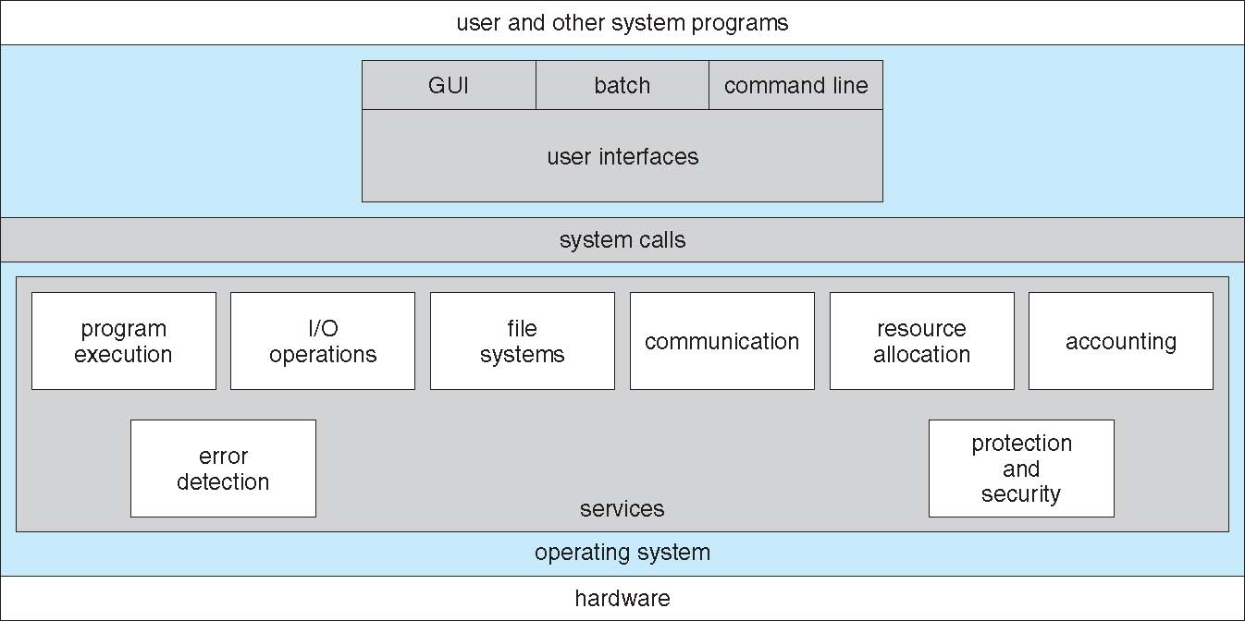
A View of Operating System Services

Slide 37
Computing environments

Slide 38
Mobile Operating Systems
Handheld smartphones, tablets, etc
What is the functional difference between them and a “traditional” laptop?
Extra feature – more OS features (GPS, gyroscope)
Allows new types of apps like augmented reality
Use IEEE 802.11 wireless, or cellular data networks for connectivity
Leaders are Apple iOS and Google Android

Slide 39
Virtualization
It is a software technology that allows operating systems to run simultaneously on the same physical machine
This software includes Emulation used when source CPU type is different from target type (i.e. PowerPC to Intel x86)
Virtualization can offer performance improvements, reduce the number of physical machines, and reduce the total cost of ownership (TCO)
Virtualization – OS natively compiled for CPU, running guest OSes also natively compiled
Virtual Machine Manager (VMM) can run natively, in which case they are also the host such as VMware ESX and Citrix XenServer

Slide 40
Virtualization

Slide 41
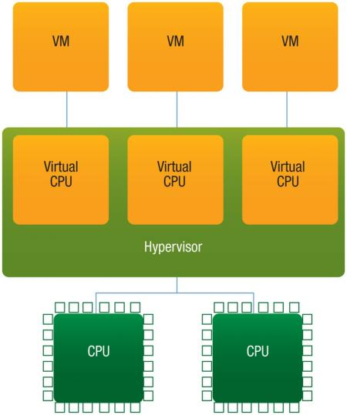
Multicore Systems and Virtualization

Slide 42
Windows Virtualization
Windows supports many virtualization features, including:
live migration. Transparently move running virtual machines either from one node of a cluster to another or from one non-clustered server to another.
dynamic virtual machine storage. Allows to add or remove virtual hard disks and physical disks while a virtual machine is running. You also can move the virtual disks of running virtual machines from one storage location to another without downtime.

Slide 43
Hyper-V architecture
Microsoft’s virtualization technology is Hyper-V. Hyper-V is a virtual machine technology that allows multiple guest operating systems to run concurrently on one computer and provide separate applications and services to client computers.
Hyper-V can be installed only on computers with 64-bit processors that implement hardware-assisted virtualization and hardware-enforced data execution protection. Specifically, you must enable virtualization support in firmware and also enable either Intel XD bit (execute disable bit) or AMD NX bit (no execute bit) as appropriate.

Slide 44
Cloud Computing
Delivers computing, storage, even apps as a service across a network
Logical extension of virtualization as based on virtualization
Amazon EC2 has thousands of servers, millions of VMs, PBs of storage available across the Internet, pay based on usage
Many types
Public cloud – available via Internet to anyone willing to pay
Private cloud – run by a company for the company’s own use
Hybrid cloud – includes both public and private cloud components
Software as a Service (SaaS) – one or more applications available via the Internet (i.e. word processor)
Platform as a Service (PaaS) – software stack ready for application use via the Internet (i.e a database server)
Infrastructure as a Service (IaaS) – servers or storage available over Internet (i.e. storage available for backup use)

Slide 45
Cloud Computing
Cloud compute environments composed of traditional OSes, plus VMMs, plus cloud management tools
Internet connectivity requires security like firewalls
Load balancers spread traffic across multiple applications

Slide 46
Cloud Computing
Cloud Computing-Open Stack
https://www.youtube.com/watch?v=Qz5gyDenqTI
Amazon EC2
http://www.youtube.com/watch?v=OLfmqcYnhUM
http://aws.amazon.com/ec2/
Google data center
http://www.youtube.com/watch?v=PBx7rgqeGG8
Windows Azure
http://channel9.msdn.com/Blogs/dunnry/What-is-Windows-Azure

Slide 47
Real-Time Embedded Systems
Real-time embedded systems most prevalent form of computers
Vary considerable, special purpose, limited purpose OS, real-time OS
Use expanding
Many other special computing environments as well
Some have OSes, some perform tasks without an OS
Real-time OS has well-defined fixed time constraints
Processing must be done within constraint
Correct operation only if constraints met

Slide 48
Open-Source Operating Systems
Operating systems made available in source-code format rather than just binary closed-source
Counter to the copy protection and Digital Rights Management (DRM) movement
Started by Free Software Foundation (FSF), GNU Public License (GPL)
Examples include GNU/Linux and BSD UNIX (including core of Mac OS X)
Can use VMM like VMware Player (Free on Windows), Virtualbox (open source and free on many platforms - http://www.virtualbox.com)
Use to run guest operating systems for exploration

Slide 49
Text Book Slides -Copy Right

Slide 50
End of Chapter 1

